Slide 1
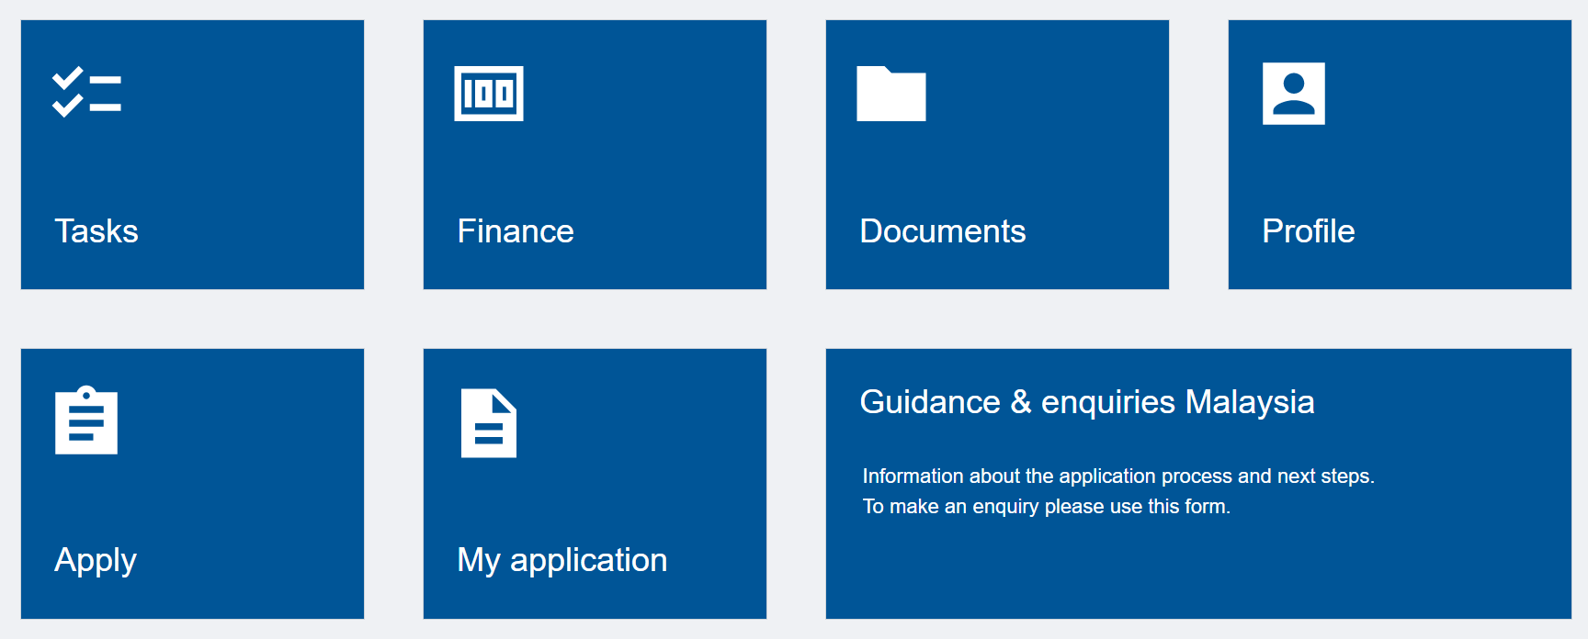
How to upload the transfer of credits form
Login to NottinghamHub
Extremely Important
You must first submit the application and pay the application fee before proceeding with this step.
Click on the ‘Documents’ tile, to start uploading your transfer of credits form.
If you have submitted more than one application, please click on the relevant folder in Categories of Documents before uploading your documents.
Continue scrolling down the same page to Add a new document. Please select:
‘Document Type’ = Admissions General
‘Document Label’ = Recognition of Other Learning (ROL)
1
2
3
Proceed to click the ‘Upload Document’ button and follow the instructions accordingly.
4

